Slide 1
INTERNATIONAL TELECOM UNIT
(ITU)
RECOMMENDATION
Organisation of the work of ITU-T

Slide 2
Group Members
Vedant Athavale (181090071)
Dhruv Singh (181090064)
Tejas Adhikari (181090068)
Aditi Patil ()
Rajkumar Shee ()
Deep Vora ()
Prathmesh Shinde

Slide 3
Topics to be Covered
Study groups and their relevant groups
Study group management
Submission and processing of contributions
Joint coordination activities

Slide 4
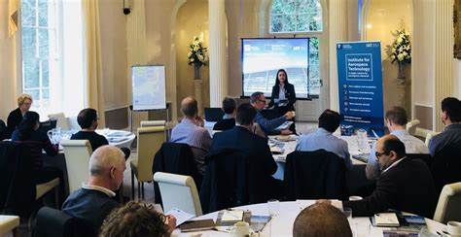
Frequency of meetings
Study groups meet to facilitate the approval of Recommendations only approval of the Director of the Telecommunication Standardization Bureau (TSB).
Meetings should not be held more frequently than is necessary to make effective progress and should take into account TSB's capabilities to provide the necessary documentation.

Slide 5
The arrangement and timing of the meeting should enable the study groups to exchange any information they may require without delay and enable the specialists concerned to avoid leaving their home countries too often.
The timetable of meetings shall be prepared and communicated to participating bodies well in advance (one year), thus, to make meetings more efficient and reduce their length.
Subject to physical and budgetary limitations and in consultation with the Director, the work of the study groups should be on a continuous basis.

Slide 6

Coordination of work
A joint coordination activity (JCA) may be formed to coordinate work relating to more than one study group. Its primary role is to harmonize planned work effort in terms of subject matter, time-frames for meetings and publication goals

Slide 7
Preparation of studies and meetings
At the beginning of each study period, an organization proposal and an action plan for the study period shall be prepared by each study group chairman with the help of TSB.
Individuals who attend the meeting without preregistration may experience a delay in receiving their documents.
If an insufficient number of contributions or notification of contributions has been submitted, no meeting should be held. The decision whether to cancel a meeting or not shall be taken by the Director.

Slide 8
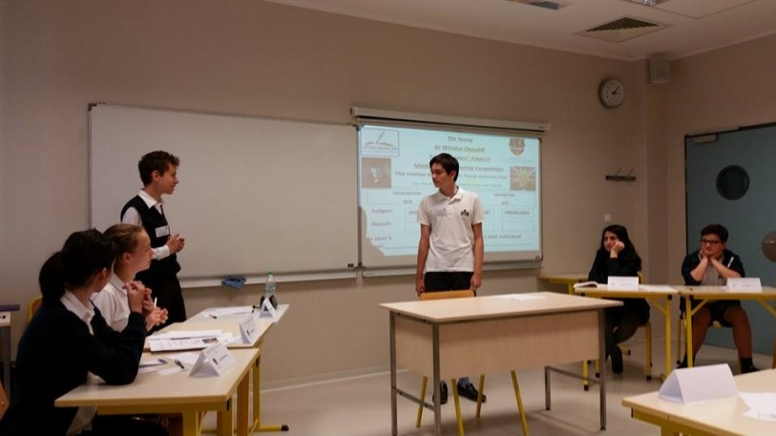
Conduct of meetings
The chairman shall direct the debates during the meeting, with the assistance of TSB.
Questions which have not elicited any contributions should not be placed on the final agenda of the meeting.
Study groups and working parties may set up ad hoc groups to study Questions allocated to those study groups and working parties.

Slide 9
For projects involving more than one study group, baseline documents may be prepared in order to provide the basis for coordinated study among the various study groups.
Chairmen will ask, during each meeting, whether anyone has knowledge of intellectual property rights issues, including patents, copyright for software or text, marks, the use of which may be required to implement or publish the Recommendation being considered.
The decision to add a new work item to the work programme shall be documented in the report of the meeting using the template in Annex A. Note that this may not be necessary to document th

